Slide 1
Box Platform Developer Workshop Cummins
Jonathan LeBlanc
Director of Developer Advocacy, Box
Twitter: @jcleblanc
Github: https://github.com/jcleblanc

Slide 2
Token Management and UI Tools

Slide 3
Downscoping Tokens

Slide 4



Token Downscoping Process
Access Token
Downscoped Token
Client-Side Code
Standard OAuth2 access token that is fully scoped for an enterprise or user.
New access token that is tightly restricted in access rights (read / write) for a file or folder.
Downscoped token is deployed to client-side code, mobile environment, or UI tool.

Slide 5
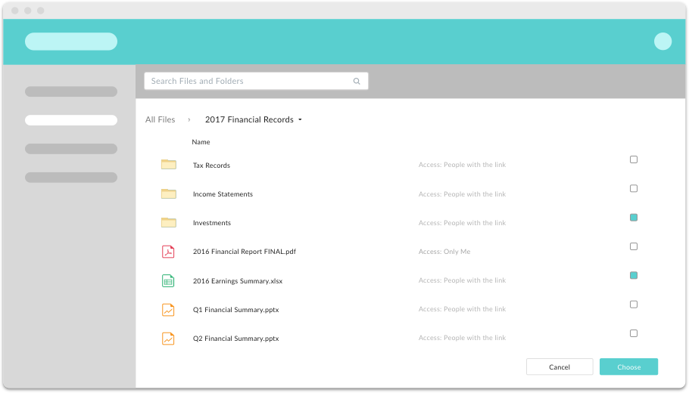
Item Scopes
item_delete: Delete file/folder.
item_download: Download file / folder.
item_preview: Preview file / folder.
item_rename: Rename file folder.
item_share: Create shared link.
item_upload: Upload new content.

Slide 6
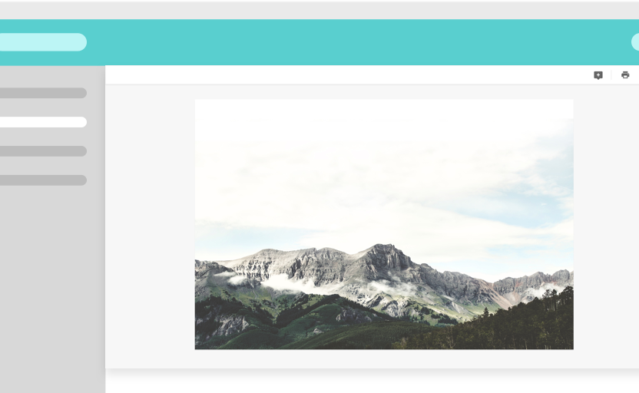
Annotation Scopes
annotation_edit: Update existing annotations on files.
annotation_view_all: View annotations from all users.
annotation_view_self: View annotations from yourself only.

Slide 7
Box UI Tools

Slide 8
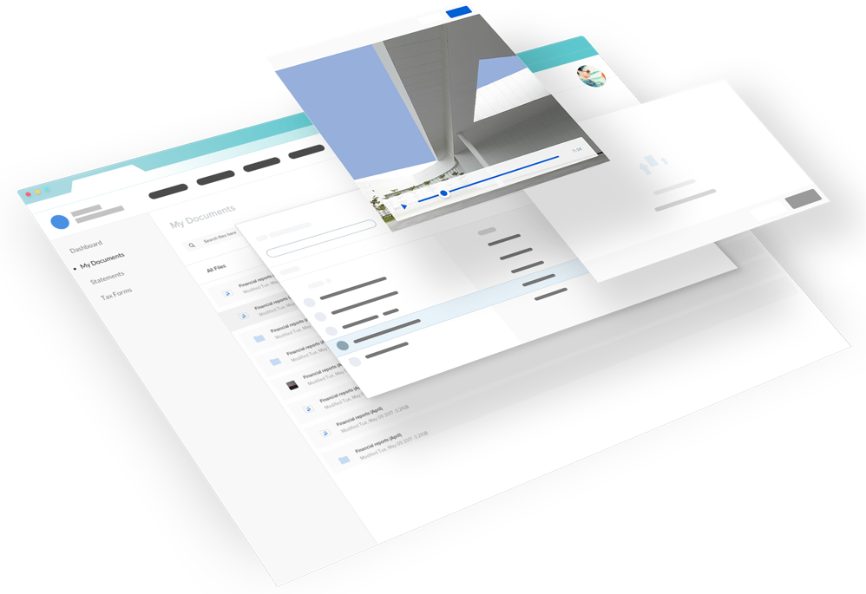
Box UI Elements
UI components build with React (JavaScript library).
Authentication and token agnostic: Works with JWT and OAuth flows.
Use type agnostic: Works with app, managed, and external user types.

Slide 9




Content Explorer
Content Picker
Navigate Box files and folders within your app.
Select Box files and folders within your app
Content Preview
Content Uploader
View docs, images, videos, 3D files, and more within your app
Drag and drop files from a device into your app / Box.

Slide 10
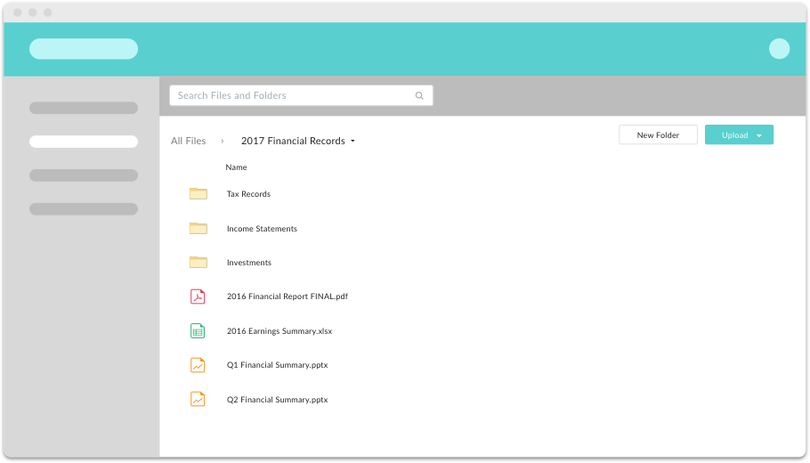
Base Scopes for Token
base_explorer
base_picker
base_preview
base_upload

Slide 11
Links and Code Samples

Slide 12
Code Samples
Token Management and UI Tools
Downscoping tokens: https://github.com/jcleblanc/box-workshops/blob/master/token-management/downscope-token.js
Box Elements (simple content explorer): https://github.com/jcleblanc/box-workshops/blob/master/token-management/box-elements.js
Box Elements (complex example for all Elements) https://github.com/jcleblanc/box-examples/tree/master/node/elements

